Slide 1

Leader: We are here together
ALL: May we ‘GO FOR GOLD!’ in our words and actions today!
Notes:
Slide 1: Teach the new gathering words, which will be the same each week.
Leader: We are here together
ALL: May we ‘GO FOR GOLD!’ in our words and actions today!

Slide 2

The Olympics
Olympic rings © Pixabay
Notes:
Slide 2: As you may know, this summer, the 2024 Olympic Games will take place in Paris – and it’s going to be an event that practically the whole world will be focused on for the 17 days between July 26th and August 11th. We’re going to be thinking about the Olympics for our assemblies this term, and over the next few weeks, we’re going to go back in time and all over the world in our Olympic time machine to find out about some inspiring stories from Olympic Games of the past – without even leaving this room!

Slide 3
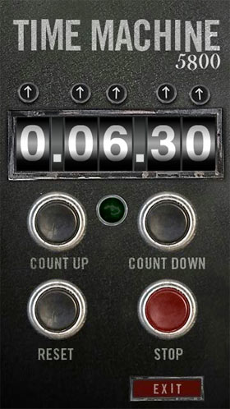
2024
CE
7 7 6
BCE
Notes:
Slide 3: So let’s start here, today! We’re going to use our Olympic time machine now to go back in time – to the time when the Olympics first started…….to 776BC (that’s almost 800 years before Jesus was born, about 2800 years ago!) Let’s go back in time…….to the Ancient Olympic Games…..

Slide 4
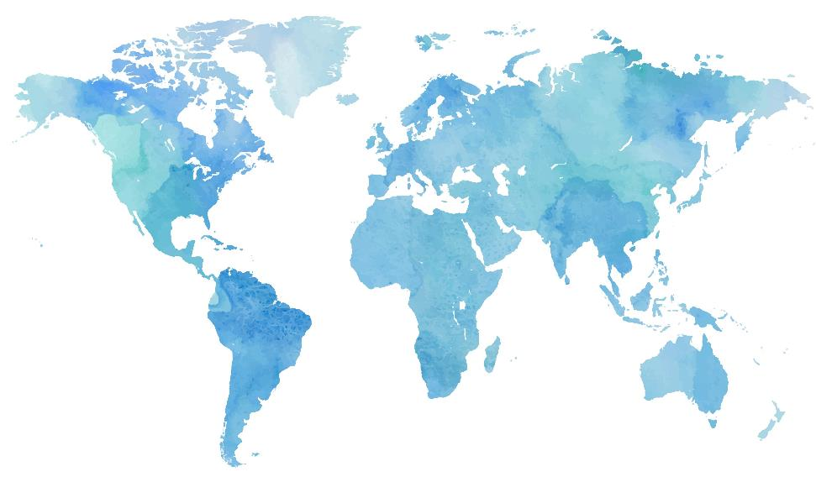
Notes:
Slide 4: The first Olympic Games took place here, in Greece [show on map]

Slide 5
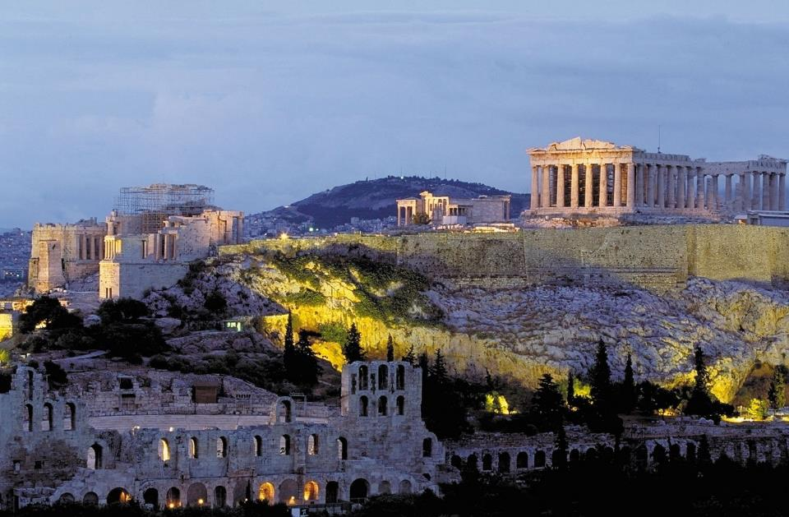
Notes:
Slide 5: This is Athens (the capital of Greece) today, where you can still see some of the ancient buildings.

Slide 6
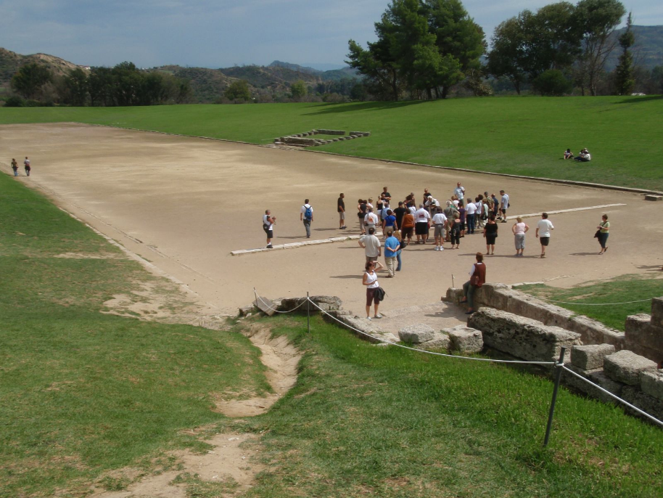
Stadium – Olympia
Notes:
Slide 6: ….and this is Olympia, where the very first Olympic Games took place, in 776BC, which we’ll hear about shortly.

Slide 7
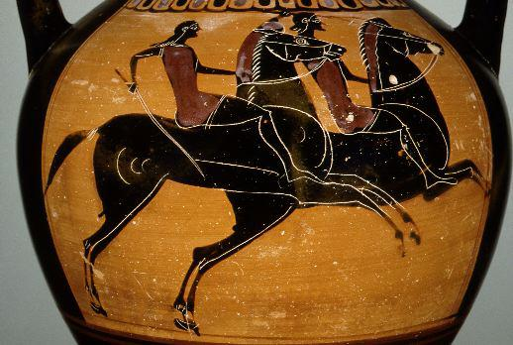
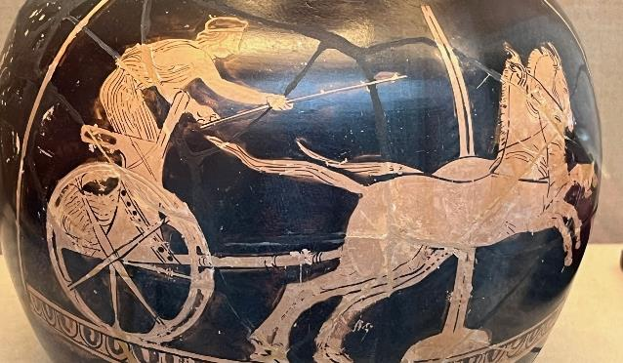
Riding and chariot racing
Notes:
Slide 7: Back then, there were races involving horses….riding and chariot races – and five other main events……

Slide 8
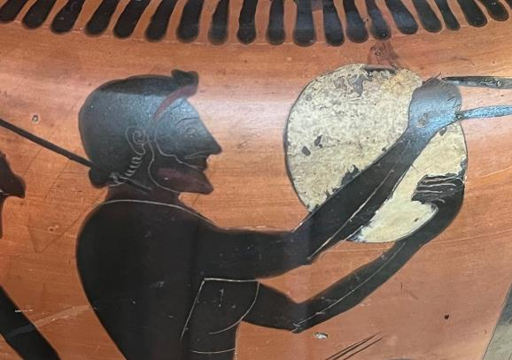
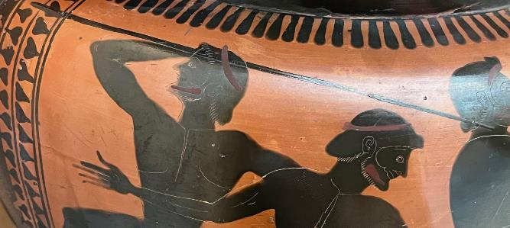
Discus
Javelin
Notes:
Slide 8:….. which included throwing events – the discus (which you can see here) and javelin –

Slide 9
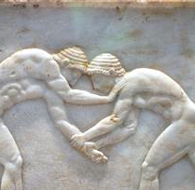
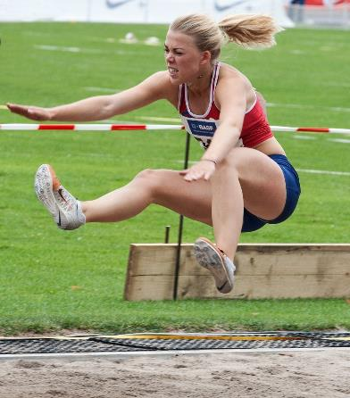
Wrestling
Long jump
Wrestlers frieze c. 510BC
Notes:
Slide 9: ….wrestling and long jump,

Slide 10
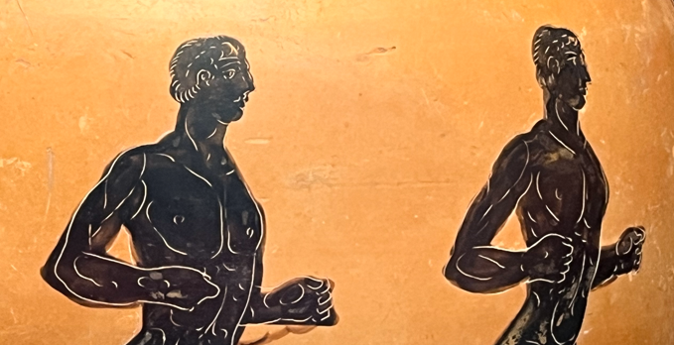
Running events
Notes:
Slide 10: ….. and lots of running for different numbers of times around the Olympic track, called the stadion. We’re going to have a go at two of those Ancient Olympic events now, right here in our assembly hall [choose volunteers to help you demonstrate or compete in the discus and javelin events explaining what you want them to do.]

Slide 11
Discus
Javelin
Notes:
Slide 11: [choose volunteers to help you demonstrate or compete in the discus and javelin events explaining what you want them to do.]

Slide 12
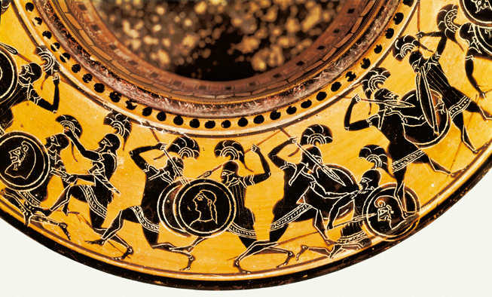
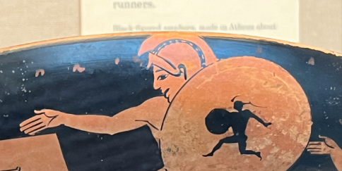
Greek foot soldiers
Notes:
Slide 12: In the Ancient Olympics, there was also a race that is nothing like anything we’d see today called the hoplitodromos – an event that had its origin in today’s story.

Slide 13
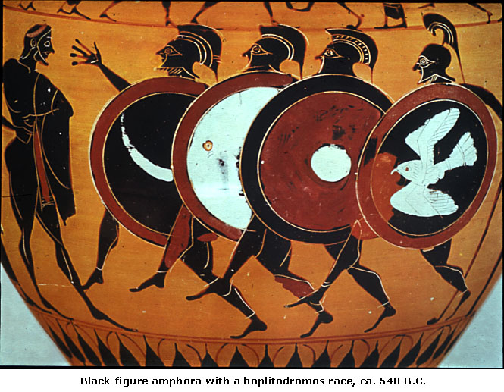
Hoplitodromos
Greek vase c. 540BC
Notes:
Slide 13: The hoplitodromos was an event for foot soldiers in the Greek army, called hoplites. Their lives depended on them being able to run and fight in heavy armour, and so this race gave Greek soldiers the opportunity to also compete for glory in the Ancient Olympics. The armour they wore weighed about 50lbs – that’s about 25 big bags of sugar! – when you’re out at play today, running around, just imagine running carrying all that weight!!

Slide 14
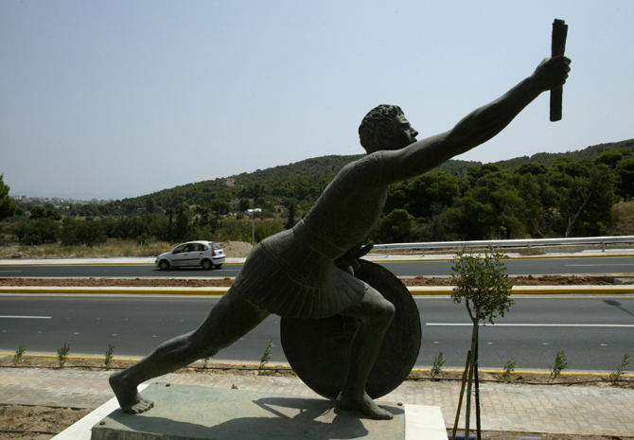
Pheidippides
Notes:
Slide 14: Today’s story, the first in our series, is a legend about a solider named Pheidippides whose statue stands by the roadside in a place called Marathon, in Greece.
Pheidippides was a foot soldier in the Athenian army. As a foot soldier, he had to be at the peak of fitness because he needed to be ready to fight and run for long distances wearing full battle armour. He carried a long spear and a large round shield – weapons and protection, because when all the foot soldiers stood together in a line – or phalanx – they would move together so that all the enemy soldiers could see was a mass of shields and spears, like a huge human tank! But sometimes, even the mighty Athenian army needed a little help – and that’s where Pheidipiddes came in.
As well as being a good soldier, Pheidippides was a great runner, and so he was chosen to run with a message to the neighbouring state of Sparta – Greece’s most fearsome warriors – to ask them to join the Athenian army and help them defeat the Persians. It took him 2 days and nights, across the mountains, but his running was all in vain, because when he got there, he found that the Spartans were celebrating a religious festival, and so not permitted to fight. And so poor Pheidippides had to run all the way back to the battlefield on the plains of Marathon with the bad news.
When he got to Marathon, the Athenian army was already lined up, ready to fight for their freedom. They were a much smaller army, but they had a plan……. Pheidippides took his place as the Athenian soldiers stood together across the hillside, their shields and spears locked ready to do battle with the Persian army. As the battle cry went up, the Athenian army charged, moving as one down the hillside. This daring move took the Persian army by surprise, and the Greeks won the battle, but Pheidippides couldn’t relax just yet! Someone needed to get word to the Greek capital city, Athens, of the great victory won against the Persians, and so off Pheidippides went again, running the 42km (that’s 26 miles) from Marathon to Athens, but this time with good news.
After two days of running, a gruelling battle and another 42km run, Pheidippides was exhausted, but he had to keep going to get word to Athens of the great victory over the Persians, and so he ran as he’d never run before. He could see Athens high up on the hilltop – he was nearly there! As he reached the very centre of the city and gasped the words ‘Victory is ours!’, Pheidippides collapsed and died.
But he died a hero, in the way that every Greek hoped for, and would be remembered in legend forever afterwards….and his run with the news of victory has been commemorated in every Olympics since –

Slide 15
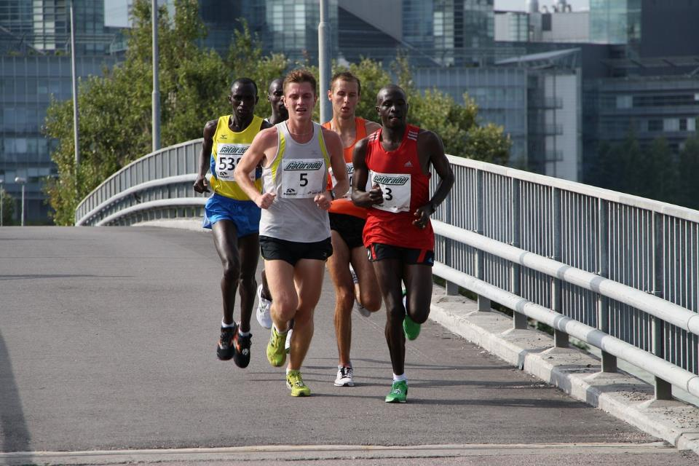
Notes:
Slide 15: …as the 26-mile race we now call the ‘Marathon’. So, if you see any of the marathon whilst watching this summer’s Olympics, you’ll know why it’s included in the running events, and can tell your family the legend of Pheidippides!

Slide 16
….I wonder what we might learn from Pheidippides’ example?....
….I wonder what things make you feel like saying ‘I give up!!’?......
…. someone once said ‘If at first you don’t succeed – try, and try, and try again!’
….I wonder how these words might help us today?.....
Notes:
Slide 16: Responding and words for worship
We’re going to be still with our own thoughts now……and think about how what we’ve heard might help us in our school community today….
We’ve heard how the marathon race is one of the toughest challenges in the Olympics, and commemorates Pheidippides’ final run from Marathon to Athens. If you’ve ever taken part in a running event of any sort, you’ll know that there are times during the run when you feel like giving up. Today, we might not be talking part in a marathon, but each day comes with its own challenges and opportunities…..
Think quietly to yourself for a few moments now…..
…. I wonder what we might learn from Pheidippides’ example?....
…..I wonder what things make you feel like saying ‘I give up!!’?......
.....maybe it’s something new you’re learning at school…..
….or something you’re practising at home…..
………
….someone once said ‘If at first you don’t succeed – try, and try, and try again!’
….I wonder how these words might help us today?.....

Slide 17
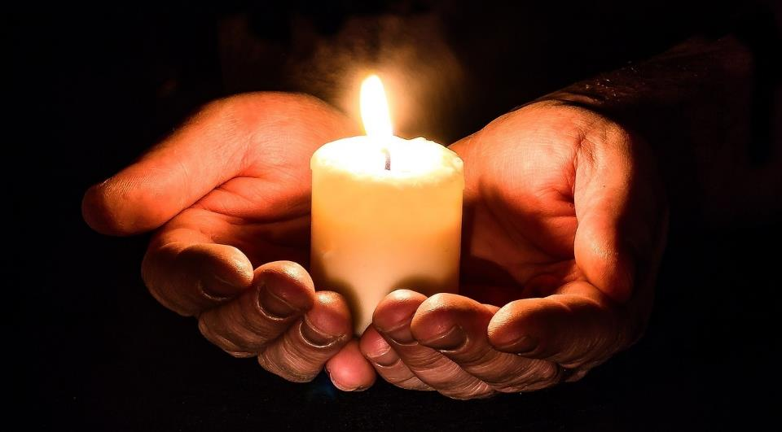
Notes:
Slide 17: Opportunity for reflection / prayer
I’m going to pray now. If this is something that you feel comfortable doing, then find a way to make the words your own. If you don’t want to pray, then use the quiet to be still with your own thoughts.

Slide 18
Pheidippides
Thank you for the story of Pheidippides, and how he didn’t give up even when he must have been exhausted. When we are faced with challenges, and feel like giving up, please help us to try, try and try again.
Notes:
Slide 18: Dear God
Thank you for the story of Pheidippides, and how he didn’t give up even when he must have been exhausted. When we are faced with challenges, and feel like giving up, please help us to try, try and try again.

Slide 19
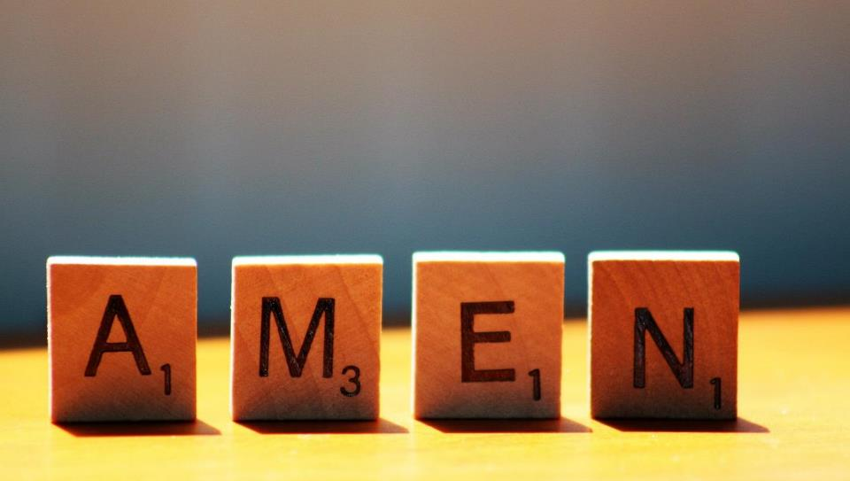

Slide 20



Leader: As we leave this place & time and go into the day ahead…
All: Let’s ‘go for gold’ in all that we do!

Slide 21

Notes:
Slide 21: Reflective areas
Make a class laurel wreath – the original Olympic ‘medal’. Provide green leaf shapes for children to use to write on their name / an ‘Olympic’ achievement for them in their work, and shape these into a class wreath, celebrating your achievements.

